Slide 1
Module overview
Why containers?
Introduction to Docker containers
Getting started with Docker
Introduction to Amazon Container Services
Wrap-up
Lab
Working with Docker containers
Labs

Slide 2
Why containers?

Slide 3
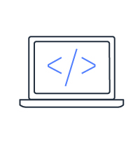
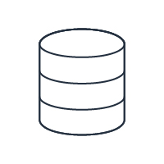
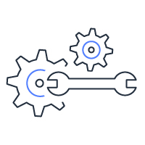
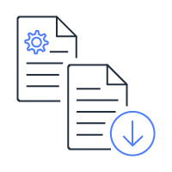
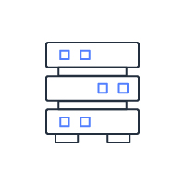
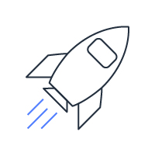
Software development lifecycle
Source code
Code repository
Build environment
Artifact
repository
Test environment
Deployment environment

Slide 4

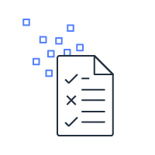
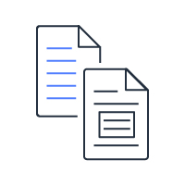
Application environment components
Runtime Engine
Code
Dependencies
Configuration
Notes:
Containers are a method of operating system virtualization that allow you to run an application and its dependencies in resource-isolated processes. Containers allow you to easily package an application's code, configurations, and dependencies into easy to use building blocks that deliver environmental consistency, operational efficiency,
developer productivity, and version control.

Slide 5

What problem do you need to solve?
Different application stacks
Different hardware deployment environments
How to run all applications across different environments
How to easily migrate from one environment to another
Static website
Web frontend
Background workers
User DB
Analytics DB
Queue
 | Dev VM | QA server | Single prod server | Onsite cluster | Public cloud | Dev laptop | Customer servers
Notes:
Prior to the introduction of containers, developers and administrators were often faced with a challenging web of complex compatibility restrictions, in which an application or workload was built specifically for its predetermined environment. If this workload needed to be migrated, for example from bare metal to a virtual machine, or from a VM to the cloud, or between service providers, then this generally meant rebuilding the application or workload entirely to ensure compatibility in the new environment.
Containers were conceived as an answer to this matrix of restriction and incompatibilities by providing a common interface for migrating applications between environments.
Challenges include:
Existing architecture can’t handle extreme loads or scale easily.
Independent development teams on different release schedules.
Needed the ability for individual services to run multiple versions in production.
Microservices architecture with a growing number of services and engineers.

Slide 6
Comparing monolithic and microservice builds
webserver
.package
Order UI
Order UI
Shipping service
Order service
Inventory service
Inventory service
Order service
Shipping service
Notes:
Let’s take a moment to look at the evolution of services to microservices. For example, many applications that utilize the Model View Controller Framework use a monolithic architecture. The application is deployed as a single file (for example Java) or a collection of files rooted at the same directory (such as Rails). All the application code runs in the same process. Scaling requires deploying multiple copies of the exact same application code to multiple servers.
There are a number of problems with the monolithic architecture. First, as features and services are added to the application, the code base will grow substantially more complex. Because all the application code runs in the same process on the server, it is difficult (if not impossible) to scale individual portions of the application. If one service is memory intensive and another CPU intensive, the server must be provisioned with enough memory and CPU to handle the baseline load for each service. Finally, and more subtlety, the engineering team structure will often start to mirror the application architecture over time.
The microservices architecture is designed to address these issues. The services defined in the monolithic application architecture are decomposed into individual services, and deployed separately from one another on separate hosts.
Within a microservices architecture, each application component runs as its own service and communicates with other services via a well-defined API. Microservices are built around business capabilities, and each service performs a single function. Microservices can be written using different frameworks and programming languages, and you can deploy them independently, as a single service, or as a group of services.

Slide 7
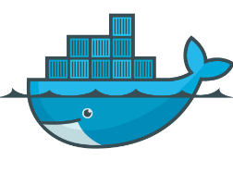
Solution: Docker containers
Runtime engine
Dependencies
docker
Code
Notes:
Containers allow you to easily package an application's code, configurations, and dependencies into easy to use building blocks that deliver environmental consistency, operational efficiency, developer productivity, and version control. Containers can help ensure that applications deploy quickly, reliably, and consistently regardless of deployment environment.

Slide 8
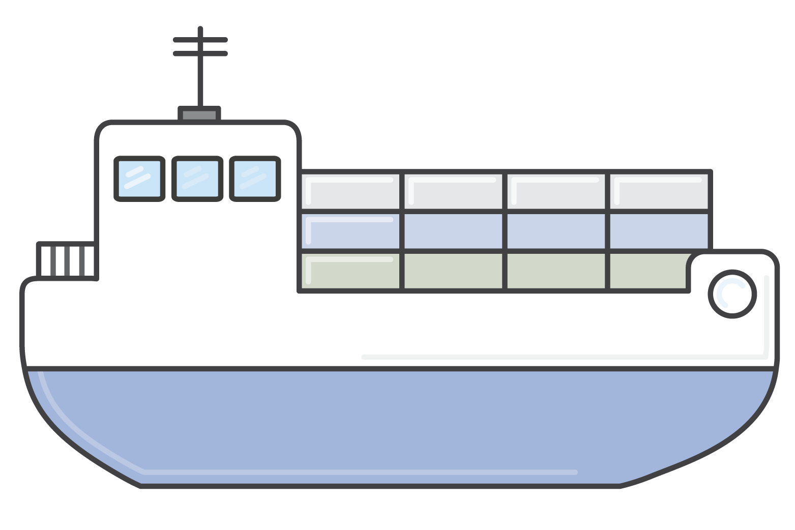
Docker containers
Simple to model services
Lightweight, portable, consistent
Any app, any language
Write and package once and run anywhere
Makes it easier to decompose your apps into microservices
docker
Notes:
A container is an atomic, self-contained package of software that includes everything Containers are a perfect fit for microservices and solve the problems that were identified on an earlier slide. Containers makes it easier to decompose your applications into microservices that can run side by side on the same instance.
Just as shipping containers standardized transport of freight goods, software containers aim to standardize the transport of applications. Ever see a stack of shipping containers on the back of a truck or ship? Everyone has. It's funny to think that, just 50 years ago, these structures had only just been invented. Prior to the introduction of the modern shipping container, merchants who wished to ship goods overseas used what is referred to as break-bulk shipping. Goods were shipped in sacks, crates, cartons, drums, casks, barrels, and boxes of various weights, shapes, and sizes. The lack of standardization made loading and unloading cargo time-consuming and cumbersome, forcing ships to spend long times moored at port. It also resulted in frequent cargo theft and damage.
In 1956, a man named Malcom McLean began hauling goods in standard-sized container boxes. The boxes were much easier to load and unload. Ships could be overhauled or designed so that these boxes could be stacked efficiently one on top of the other. The system proved so popular that an ISO standard was created to standardize the size, capacity, and latching mechanisms for containers so that they could be easily moved between ships, trucks, and railroad cars created by different manufacturers.
The people who created Docker asked themselves: Why can't we do the same thing for software applications? Indeed, software applications are still in much the same state as shipping containers were 50 years ago. Every developer is familiar with how difficult it is to make an application that works perfectly well on a development box function equally well in testing, staging, or production. One of the largest headaches experienced by new developers on a large software development project is getting the build to work on their local machines.
The bright idea of the people behind Docker was to create a container that contained everything a software application would need to run - all of its files, file system structure, daemons, libraries, and application dependencies. Let's see in the subsequent slides exactly how this works.
By using containers, you decouple applications from operating systems. This ensures that users have a clean Linux operating system and can run everything else in an isolated container.
The Linux kernel features - cgroups and namespaces, create walls between containers and other processes running on the host. Linux namespaces, wrap a set of system resources and present them to a process to make it look like they are dedicated to that process. Linux cgroups, govern the isolation and usage of system resources, such as CPU and memory, for a group of processes. For example, if you have an application that takes up a lot of CPU cycles and memory, such as a scientific computing application, you can put the application in a group to limit its CPU and memory usage. Namespaces deal with resource isolation for a single process, while cgroups manage resources for a group of processes.
Sources:
http://www.worldshipping.org/about-the-industry/history-of-containerization/the-birth-of-intermodalism

Slide 9
Are virtual machines and containers similar?
Containers are isolated, but share OS and, where appropriate, bins and libraries.
App
A
App
A’
App
B
Virtual machines
Bins and
libs
Bins and
libs
Bins and libs
Guest OS
Guest OS
Guest OS
App
A
App
A’
App
B
App
B’
App
B’
Container
Bins and libs
Bins and libs
Hypervisor
Docker
Host Machine
Host OS
Host OS
Server
Server
Notes:
When hearing the capabilities of containers, it is somewhat intuitive to think that it sounds just like a virtual machine. However, the differences are in the details. The number one difference is the lack of a hypervisor requirement. Containers can run on any Linux system with appropriate kernel feature support and the Docker daemon present. This makes them extremely portable. Your laptop, your VM, your EC2 instance, and your bare metal server are all potential hosts.
The lack of a hypervisor requirement also results in almost no noticeable performance overhead. The processes are talking directly to the kernel and are largely unaware of their container silo. Most containers boot in just a couple of seconds.
Where VMs are isolated at the operating system level, containers are isolated at the kernel level. This means that several applications can run on a single host operating system, and yet still have their own file system, storage, RAM, libraries, essentially, their own "view" of the system.

Slide 10
Introduction to Docker containers

Slide 11

When to use Docker containers
Distributed apps and microservices
CI/CD Pipelines
Batch Jobs
Breaking up monoliths
Service-oriented architecture
Short-lived jobs
Variety and flexibility
Elastic
Packaging your code in a Docker images
Test
Deploy in production
Notes:
Containers in general are perfect for microservices and Amazon ECS further simplifies such architectures:
Containers make services easy to model in an immutable image with all of your dependencies.
Containers can use any application and any programming language.
The container image is a versioned artifact, so you can track your container images to the source they came from.
You can test your containers locally, and deploy the same artifact to scale.
Batch Jobs
Docker containers are suited for batch job workloads. Batch jobs are often short-lived and embarrassingly parallel. You can package your batch processing application into a Docker image so that you can deploy it anywhere, such as in Amazon ECS.
CI/CD
Continuous integration and continuous deployment (CI/CD) is a common process that are based on Docker containers. You can create a pipeline that takes the following actions:
Monitors changes to a source code repository
Builds a new Docker image from that source
Pushes the image to an image repository such as Amazon ECR or Docker Hub
Updates your Amazon ECS services to use the new image in your application

Slide 12
Microservices architecture with containers
Microservices can be implemented as separate Docker containers.
You can have multiple services per host and multiple versions running simultaneously.
Customers v1.0
Products v1.0
Customers v2.0
Orders v1.0
Orders v1.0
Notes:
Using Docker, all of the different tiers of your Web application architecture could be constructed as independent Docker containers. If you are deploying a microservices architecture, you could implement each service as its own separate Docker container. Such an approach has several advantages:
You can distribute running services across instances on an Amazon EC2 fleet.
You can run multiple services on a single Amazon EC2 instance within your fleet. This allows maximizing the CPU and memory usage of your existing instances.
You can run multiple different versions of a service simultaneously - even on the same machine, assuming that they bind to different ports. This allows you to release breaking changes in services while retaining backward compatibility with applications that may not have yet been modified to work against the new version.

Slide 13

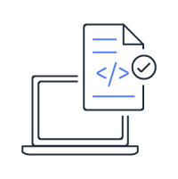
Development lifecycle
Create the container image
Publish the image
Container
Registry
Container image
Amazon Elastic Container Service Amazon Elastic Kubernetes Service AWS Fargate
Create the Dockerfile
Run and test the container on your machine
Notes:
To deploy applications on Amazon ECS, your application components must be architected to run in containers. A Docker container is a standardized unit of software development, containing everything that your software application needs to run: code, runtime, system tools, system libraries, etc. Containers are created from a read-only template called an image.
Images are typically built from a Dockerfile, a plaintext file that specifies all of the components that are included in the container. These images are then stored in a registry from which they can be downloaded and run on your cluster.

Slide 14
Docker image
Container (writable)
Collection of files
Used to launch containers
Instructions stored in a Dockerfile
Reference parent image
Image (add Apache)
Image (add emacs)
Base Image (Debian)
Kernel (bootfs)
Notes:
A Docker image is a collection of files. Base images (Debian, Ubuntu, busybox, fedora, etc.) are what you build your own custom images on top of.
Images are layered and each layer represents a diff (or what changed) from the previous layer. Each Docker image is actually a stack of images. Each layer itself is an image.
When Docker mounts the rootfs, it starts read-only, as in a traditional Linux boot, but then, instead of changing the file system to read-write mode, it takes advantage of a union mount to add a read-write file system over the read-only file system. In fact there may be multiple read-only file systems stacked on top of each other.

Slide 15

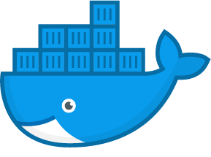
Docker image registry
Amazon Elastic Container Registry (Amazon ECR)
Fully managed
Secure: Encryption at rest, AWS Identity and Access Management integration
Scalable and highly available
Integrated with Amazon ECS and Docker CLI
Docker Hub
Public repository of images
Provides private image storage
Private Repositories
Amazon ECR
Docker Hub
Notes:
Amazon Elastic Container Registry (Amazon ECR) is a fully-managed Docker container registry that makes it easy for you to store, manage, and deploy Docker container images. Amazon ECR can be used standalone and also has deep integration with Amazon ECS, simplifying your development to production workflow. Amazon ECR eliminates the need to operate your own container repositories or worry about scaling the underlying infrastructure. Amazon ECR hosts your images in a highly available and scalable architecture, allowing you to reliably deploy containers for your applications.
Amazon ECR eliminates the need to operate and scale the infrastructure required to power your container registry. Amazon ECR uses Amazon S3 for storage to make your container images highly available and accessible, allowing you to reliably deploy new containers for your applications. Amazon ECR transfers your container images over HTTPS and automatically encrypts your images at rest. You can configure policies to manage permissions for each repository and restrict access to IAM users, roles, or other AWS accounts. Amazon ECR integrates with Amazon ECS and the Docker CLI, allowing you to simplify your development and production workflows. You can easily push your container images to Amazon ECR using the Docker CLI from your development machine, and Amazon ECS can pull them directly for production deployments.

Slide 16
Getting started with Docker

Slide 17
Create the Dockerfile
FROM ubuntu:18.04
# Install dependencies
RUN apt-get update -y
RUN apt-get install -y apache2
# Install apache and write hello world message
RUN echo "Hello World!" > /var/www/index.html
# Configure apache
RUN a2enmod rewrite
RUN chown -R www-data:www-data /var/www
ENV APACHE_RUN_USER www-data
ENV APACHE_RUN_GROUP www-data
ENV APACHE_LOG_DIR /var/log/apache2
EXPOSE 80
CMD ["/usr/sbin/apache2", "-D", "FOREGROUND"]

Slide 18
Docker CLI commands
Command | Information
docker build | Build an image from a Dockerfile.
docker images | List images on Docker host.
docker run | Run an image.
docker ps | List running containers.
docker pull | Download or update an image.
docker push | Share your images to the registry

Slide 19
Docker CLI commands (cont)
Command | Information
docker stop | Stop a running container.
docker rm | Delete an instance of a container.
docker rmi | Delete an image.
docker exec | Run a command in a container.
docker logs | View container log output.
docker inspect | Inspect container information.

Slide 20
Amazon ECR
# Create a repository called hello-world
> aws ecr create-repository --repository-name hello-world
# Build or tag an image
> docker build -t hello-world .
> docker tag hello-world aws_account_id.dkr.ecr.us-east-1.amazonaws.com/hello-world
# Authenticate Docker to your Amazon ECR registry
> aws ecr get-login
> docker login -u AWS -p <password> -e none aws_account_id.dkr.ecr.us-east-1.amazonaws.com
# You can skip the `docker login` step if you have amazon-ecr-credential-helper setup.
# Push an image to your repository
> docker push aws_account_id.dkr.ecr.us-east-1.amazonaws.com/hello-world
Notes:
Amazon ECR is a managed AWS Docker registry service. Amazon ECR provides a command line interface and APIs to create, monitor, and delete repositories and set repository permissions. You can perform the same actions in the Amazon ECR Management Console, which can be accessed via the “Repositories” section of the Amazon ECS Console. Amazon ECR also integrates with the Docker CLI allowing you to push, pull, and tag images on your development machine.
Amazon ECR provides a secure, scalable, and reliable registry. Amazon ECR supports private Docker repositories with resource-based permissions using AWS IAM so that specific users or Amazon EC2 instances can access repositories and images. Developers can use the Docker CLI to author and manage images.
For information on Authenticating Amazon ECR Repositories for Docker CLI with Credential Helper, see https://aws.amazon.com/blogs/compute/authenticating-amazon-ecr-repositories-for-docker-cli-with-credential-helper/.

Slide 21
Introduction to Amazon Container Services

Slide 22



Evolution of container management
Amazon EC2
Docker container
Docker containers
Notes:
First, there was Amazon EC2. Next, came Docker containers where customers started containerizing applications within EC2 instances. Running one container is fine and rightfully so, you might think to use them a lot. So you add another container. Maybe add a few more that you can still manage.

Slide 23

Management challenges
I need an easier way to manage large clusters of instances, place containers, and run services.
Notes:
What about when you have a fleet and each of container is an application with different lifecycles, needs, customizations? What about the infrastructure that’s running them? You need to figure out a way to manage containerized applications at scale, still leveraging though the same levels of flexibility that a container gives you.
Also, you want to secure your computing platform, making sure that you still have control on customers and operators that are consuming the platform. Now you’re suddenly managing a cluster and cluster management is hard. You need a way to intelligently place your containers on the hosts that have the resources and that means you need to know the state of everything in your system.

Slide 24


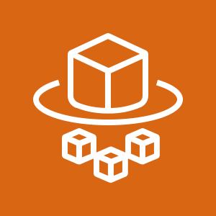
Amazon container services
Management
Deployment, scheduling, scaling & management of containerized apps
Amazon ECS
Amazon Elastic Kubernetes Service
Hosting
Where the containers run
Amazon EC2
AWS Fargate
Image Registry
Repo for the containers images
Amazon ECR
Notes:
Containers are an increasingly important way for developers to package and deploy their applications. They are lightweight and provide a consistent, portable software environment for applications to easily run and scale anywhere. Building and deploying microservices, running batch jobs, for machine learning applications, and moving existing applications into the cloud are just some of the popular use cases for containers.
AWS offers multiple container products to help you deploy, manage, and scale containers in production.
There are a number of ways to run containers on AWS, including Amazon Elastic Container Service (ECS) is a highly scalable, high performance container management service. AWS Fargate is a technology for Amazon ECS that lets you run containers in production without deploying or managing infrastructure. Amazon Elastic Container Service for Kubernetes (EKS) makes it easy for you to run Kubernetes on AWS. Amazon Elastic Container Registry (ECR) is a highly available and secure private container repository that makes it easy to store and manage your Docker container images, encrypting and compressing images at rest so they are fast to pull and secure.

Slide 25
Amazon Elastic Container Service
Scheduling and orchestration
Amazon ECS
Cluster manager
Placement engine
Notes:
Amazon Elastic Container Service (Amazon ECS) is a fully-managed container orchestration service that helps you easily deploy, manage, and scale containerized applications on AWS. With Amazon ECS, you do not have to install and operate your own container orchestration software, manage and scale a cluster of virtual machines, or schedule containers on those virtual machines. Amazon ECS is designed from the ground up to be deeply integrated with the rest of the AWS platform, working with services like Amazon Elastic Load Balancer, IAM, Amazon ECR, CloudWatch, AWS CloudFormation, and CloudTrail. With Amazon ECS, you get a highly reliable solution that provides a native AWS API experience for containers, similar to EC2 for virtual machines.
Amazon ECS:
Manages the execution of containerized application in a highly available manner.
Manages clusters of EC2 Instances supporting Docker containers.
Monitors resource consumption and availability requirements.

Slide 26

Amazon EC2 launch type
Scheduling and orchestration
Amazon ECS
Cluster manager
Placement engine
EC2 Instance
EC2 Instance
EC2 Instance
OS
Docker agent
ECS agent
OS
Docker agent
ECS agent
OS
Docker agent
ECS agent

Slide 27
AWS Fargate launch type
Scheduling and orchestration
Amazon ECS
Cluster manager
Placement engine
AWS Fargate
Notes:
AWS Fargate is a technology for deploying and managing containers without having to manage any of the underlying infrastructure. You no longer have to provision, configure, and scale clusters of virtual machines to run containers. Simply upload your container image, specify resource requirements, and AWS Fargate launches containers for you within seconds. AWS Fargate enables you to focus on designing and running the application, not the infrastructure.
AWS Fargate enables developers to focus 100% on their applications. With AWS Fargate, instance management goes away.
The AWS Fargate launch type only supports using container images hosted in Amazon ECR or publicly on Docker Hub. Private repositories are currently only supported using the EC2 launch type.

Slide 28





Compute auto scale up
AWS Cloud
New services
CloudWatch event
Developers
Amazon ECS
EC2 instance
EC2 instance
Amazon CloudWatch
ECS cluster
Event: Per cluster CPU, memory reservation, or usage

Slide 29

Amazon Elastic Kubernetes Service
mycluster.eks.amazonaws.com
kubectl
Availability
Zone 1
Availability
Zone 2
Availability
Zone 3
Notes:
Kubernetes is open source software that allows you to deploy and manage containerized applications at scale. Kubernetes groups containers into logical groupings for management and discoverability, then launches them onto clusters of EC2 instances. Using Kubernetes you can run containerized applications including microservices, batch processing workers, and platforms as a service (PaaS) using the same toolset on premises and in the cloud.
Amazon Elastic Container Service for Kubernetes (Amazon EKS) is a managed service that makes it easy for you to run Kubernetes on AWS without needing to become an expert in operating Kubernetes. Amazon EKS runs the Kubernetes management infrastructure for you across multiple AWS Availability Zones to eliminate a single point of failure. Amazon EKS is certified Kubernetes conformant so you can use existing tooling and plugins from partners and the Kubernetes community. Applications running on any standard Kubernetes environment are fully compatible and can be easily migrated to Amazon EKS.
Amazon EKS provisions and scales the Kubernetes control plane, including the API servers and backend persistence layer, across multiple AWS availability zones for high availability and fault tolerance. Amazon EKS automatically detects and replaces unhealthy control plane nodes and provides patching for the control plane. Amazon EKS is integrated with many AWS services to provide scalability and security for your applications. These services include Elastic Load Balancing for load distribution, IAM for authentication, Amazon VPC for isolation, AWS PrivateLink for private network access, and AWS CloudTrail for logging.

Slide 30
What are my options?
AWS container services
1
Choose your orchestration tool.
Amazon ECS
Amazon EKS
2
Choose your launch type.
Amazon EC2
AWS Fargate
Amazon EC2

Slide 31
Wrap-up

Slide 32
Knowledge check
☑
☑
☒
True
False
Containers are an increasingly important way for developers to package and deploy their applications.
Containers can use any application and any programming language.
With ECS, you have to install and operate your own container orchestration software, plus manage and scale a cluster of virtual machines.
☒
☑
☑
To delete an instance of a container, you use the docker rmi command.
AWS Fargate is a technology for deploying and managing containers without having to manage any of the underlying infrastructure.
Amazon ECR integrates with Amazon ECS but you can also store your container images on Docker Hub.
Notes:
Read left to right:
(True)
(True)
(False) With ECS, you do not have to install and operate your own container orchestration software, manage and scale a cluster of virtual machines.
(False) To delete an instance of a container, you use the docker rm command. To delete an image, you use the docker rmi command.
(True)
(True)

Slide 33
Lab 6: Working with Docker containers

Slide 34

Lab overview
Docker
AWS Cloud
EC2 instance
Dockerfile
Docker image
Running container (testing)
Duration
45 mins.
Notes:
In this lab, you will:
Launch an EC2 instance with user-data
Create a Dockerfile
Create a Docker image using a dockerfile
Run a container from a Docker image
Interact with and administer your containers
Create an ECR Repository
Authenticate the Docker client to ECR
Push a Docker image to ECR

Slide 35
Lab follow-up
What did you do?
Did you connect by using AWS Cloud9?

Slide 36
Thank you

Slide 37
Appendix

Slide 38
Dockerfile best practices
Reduce build image sizes and number of layers.
Only bring what you need at runtime.
Always tag each build with any of these schemes:
Semantic version (i.e., “1.3.2-9”)
Git SHA (i.e., “aebcbca”)
Build Number (i.e., “127”)
Build Id (i.e., “511d5e51-b415-4cb2-b229-b3c8a46b7a2f”)
For multi-region, push to all regions, pull from the same region.
Notes:
For Dockerfile writing best practices, see https://docs.docker.com/develop/develop-images/dockerfile_best-practices/#label.

Slide 39
Logging with Amazon CloudWatch logs
Supported Docker Logging Drivers.
json-file, syslog, journald, gelf, fluentd, awslogs.
stdout/stderr outputs are automatically sent by the driver.
awslogs sends logs to Amazon CloudWatch Logs.
Log group for a specific service.
Log stream for each container.
Amazon CloudWatch Logs => Other services.
Search, Filter, Export to Amazon S3, Send to Amazon Kinesis, AWS Lambda, Amazon Elasticsearch Service.

